Slide 1
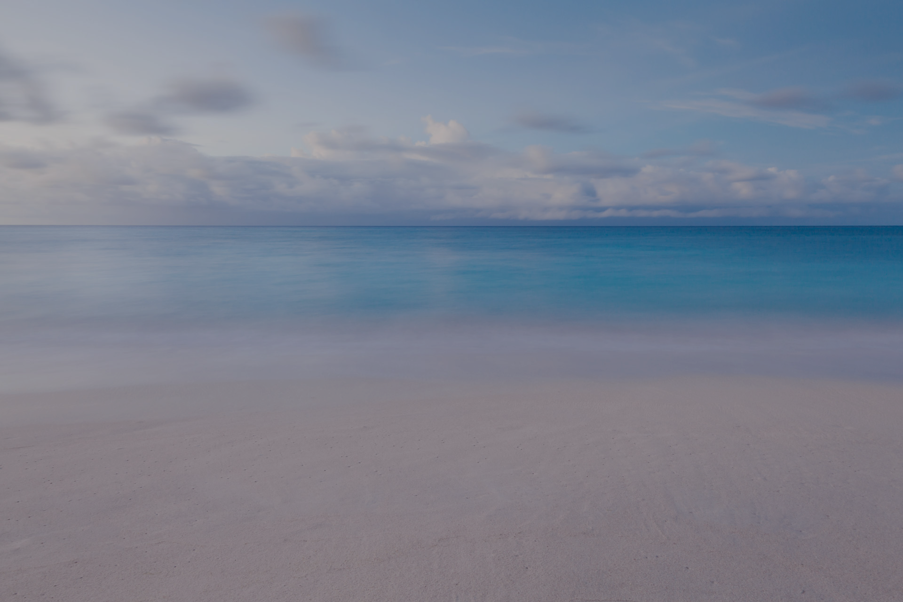
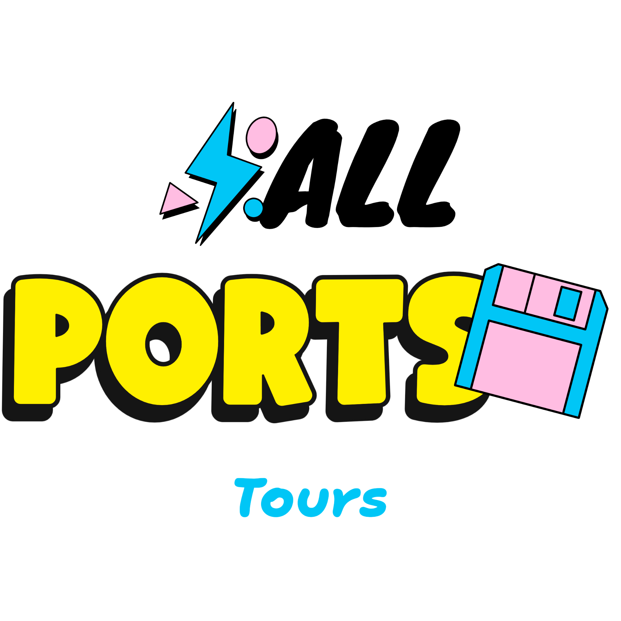
All Ports Tours
Executive Briefing
Finals-XX
All Ports Tours Security Assessment Re-Briefing
Notes:
Hello All Ports Tours Executive board, we are Finals-XX. Today we will discuss the security reassessment for All Ports Tours.

Slide 2
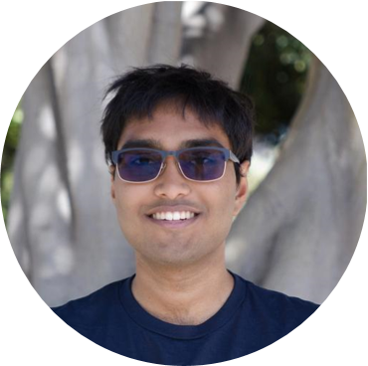
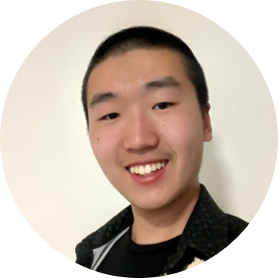
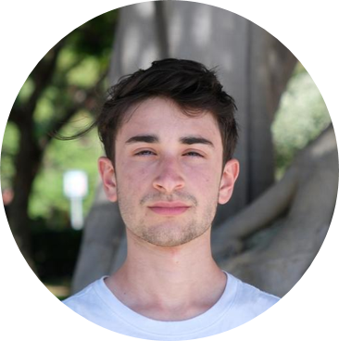
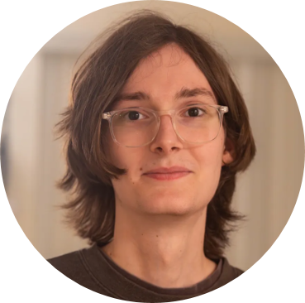
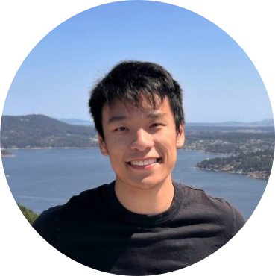
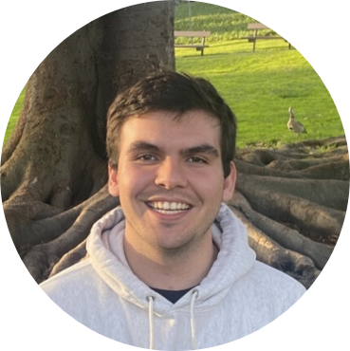
Our Team
Finals-XX
Team Lead
Dhruv Kandula
Active Directory Specialist
Andy Gu
Active Directory Specialist
Drew Levy
Website & QA Specialist
Alex Loan
Website & API Specialist
Eddie Zhu
Cloud & AI Specialist
Colin Harrison
Notes:
First, let me introduce our team. I am Dhruv, our team lead. Here, we have our Active Directory experts Andy and Drew. Next, we have our web application specialists Alex and Eddie. Finally, our Cloud and AI specialist Colin.

Slide 3
Agenda
Finals-XX
Executive Summary
Scope
Business Impact
Strengths and Recommendations
Objectives
Q&A
Notes:
Here’s a brief overview of what we will go over today. First, we will go over our key findings in the executive summary. Then, we will talk about the impacts of our findings on the APT business. Next, we will cover our goals of this engagement. Afterwards we will discuss which systems we conducted our tests on. Next, we will go over some of the specific strengths and weaknesses we found in your systems, with some recommendations to improve your security posture. Finally, we will open up the floor for some questions.

Slide 4
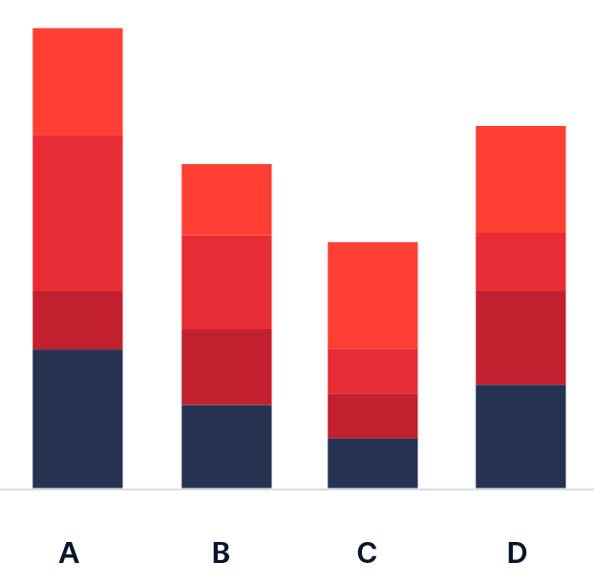
58%
15
Executive Summary
52
4000+
Finals-XX
All Ports Tours
of vulnerabilities patched since last assessment
Total vulnerabilities and findings across the network
Vulnerabilities still present during second assessment
Users vulnerable to data leakage
Statistics sourced from initial and secondary assessments.
Notes:
TODO: BAR CHART OF VULNS BY RISK, FILLED IN TO SHOW HOW MUCH IS REDISCOVERED

Slide 5
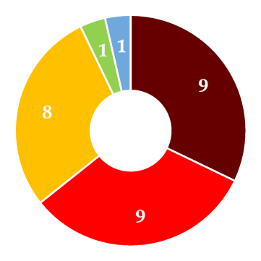
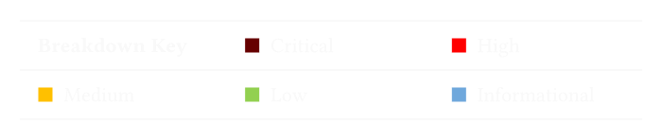
35
24
Finals-XX
Vulnerability Breakdown
Low
Critical
Novel vulnerabilities discovered since last assessment
Medium
Vulnerabilities left unremediated after
last assessment
High
Data includes vulnerabilities identified in last assessment but not described in depth due to space limitations.

Slide 6
Business Impact
Finals-XX
All Ports Tours
Confidentiality
Exfiltration of customer data (PII)
Exposure of internal company documents
Employee credential leakage
Integrity
Data modification or defacement
Services could spread misinformation
Hijack cruise control
Availability
Disable critical systems
Endanger customer safety
Guest services disruption
Notes:
Remember to mention: Business impact is solely a description of what Finals-XX believes to be the worst-case scenario and does not necessarily reflect the future of the APTCL.
Next we will cover how our findings will impact APT’s business and security

Slide 7
Finals-XX
All Ports Tours
Objectives
MAINTAIN PERSPECTIVE
No security assessment is perfect.
Uphold objectivity to the greatest extent possible.
Abide by the scope of the assessment.
MITIGATIONS
Recommend mitigations for every vulnerability.
Ensure mitigations can be verified via clear reproduction steps.
BUSINESS IMPACT
Quantify the business risk of all findings.
Convey the importance of every risk clearly.
WEAKNESS DISCOVERY
Thoroughly determine vulnerabilities in network.
Re-assess past weaknesses.
01
02
03
04
Notes:
Our team was extremely careful to stay in-scope during our penetration assessments. We tested the production environment which included key services like navigation and temperature control, guest services like the Jellyfin media server, and AWS cloud services. We also did a thorough test of the security preparedness of all ports tours staff through a vishing campaign.

Slide 8




Finals-XX
All Ports Tours
Scope
Production Network
Development Network
AWS Cloud
Social Engineering
The production environment.
Contains IP range 10.0.1.0/24.
The development environment.
Contains IP range 10.0.2.0/24.
The Amazon Web Services
(AWS) cloud application.
Minimal social engineering
aspects were permitted.
Notes:
Our team was extremely careful to stay in-scope during our penetration assessments. We tested the production environment which included key services like navigation and temperature control, guest services like the Jellyfin media server, and AWS cloud services. We also did a thorough test of the security preparedness of all ports tours staff through a vishing campaign.

Slide 9
Finals-XX
All Ports Tours
Scope
Production Network
Development Network
Social Engineering
The production environment.
Contains IP range 10.0.1.0/24.
The development environment.
Contains IP range 10.0.2.0/24.
Minimal social engineering
aspects were permitted.
Notes:
Our team was extremely careful to stay in-scope during our penetration assessments. We tested the production environment which included key services like navigation and temperature control, guest services like the Jellyfin media server, and AWS cloud services. We also did a thorough test of the security preparedness of all ports tours staff through a vishing campaign.

Slide 10
Finals-XX
All Ports Tours
Strengths
Service isolation
Up-to-date systems
One-time credentials
Effective logging
Services appeared to be properly isolated, limiting the impact of vulnerabilities.
Systems and services were up-to-date, preventing the use of well-known exploits.
Important credentials were not reused across the network, also limiting the impact of vulnerabilities.
Logging and monitoring was extensively utilized throughout the network, aiding threat detection.

Slide 11
Finals-XX
All Ports Tours
Recommendations
Multi-factor authentication
Endpoint detection
& response
Role-based
access control
Strong password
policy
Require an additional layer of verification to mitigate impact of stolen credentials.
Protect company infrastructure by actively blocking and responding to incoming threats.
Ensure that users have minimal privileges required for necessary business operations.
Enforce secure password complexity requirements to reduce risk of unauthorized access.
Cisco Duo
Microsoft Authenticator
OKTA Adaptive MFA
CrowdStrike
SentinelOne
Sophos
AD Group Policy
Microsoft Entra
IBM Verify Identity
NIST Guidelines
CISA Recommendations
OWASP Standards
Notes:
Password policies linked:
https://pages.nist.gov/800-63-4/sp800-63b/passwords/
https://www.cisa.gov/audiences/small-and-medium-businesses/secure-your-business/require-strong-passwords
https://cheatsheetseries.owasp.org/cheatsheets/Authentication_Cheat_Sheet.html

Slide 12


Q&A
Finals-XX
cptc11-finals-xx@cptc.team
Notes:
Image is public domain: https://www.publicdomainpictures.net/en/view-image.php?image=21486&picture=beach-background

Slide 13
Finals-XX
All Ports Tours
Appendix I: Risk
Risk Matrix |  | Impact (CVSS Score)
 |  | Informational | Low | Medium | High | Critical
Likelihood | Low | Informational | Low | Low | Medium | High
 | Medium | Informational | Low | Medium | High | Critical
 | High | Informational | Medium | Medium | High | Critical

